Slide 1
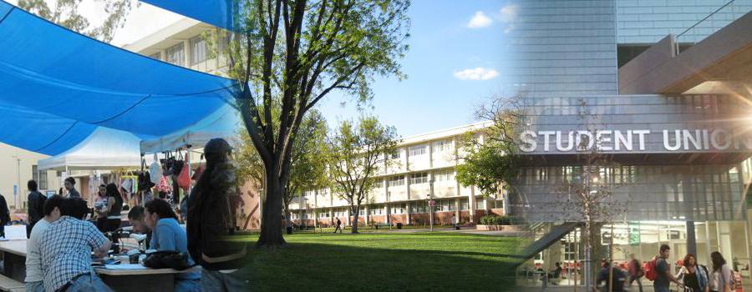
Los Angeles City College

Slide 2
Content
Introduction
Enrollment Trends
Demographic Characteristics
Transfers
Financial Aid
Math Sequence

Slide 3
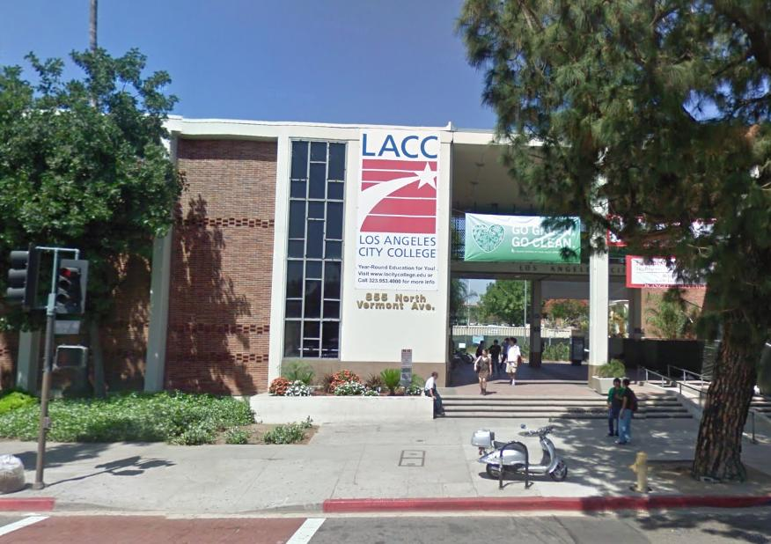
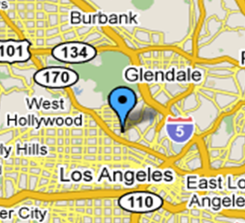
Introduction
Located in the east corner of Hollywood, just minutes from Hollywood and Downtown LA
Students enrolled: 20,598 (2012)
Website: www.lacitycollege.edu

Slide 4
Enrollment Trends
Enrollment increased between 1929 and 1975; decreased after 1975 and increased after 2001

Slide 5
Enrollment Trends
Between 2006 and 2009, enrollment of under 20, 20-24 and 25-34 age groups increased

Slide 6
Enrollment Trends
Between 2000 and 2009, enrollment of US Citizens increased; enrollment of Permanent Residents decreased during the same period

Slide 7
Enrollment Trends
Between 2000 and 2009, Hispanics were the largest ethnic student group

Slide 8
Enrollment Trends
Between 2000 and 2009, there was a larger proportion of females in the college.

Slide 9
Enrollment Trends
Between 2000 and 2009, the percent of English speakers enrolled in LACC increased; the opposite occurred for Spanish speakers

Slide 10
Demographics Characteristics
Between 2000 and 2009, the majority of LACC students were U.S. high school graduates.

Slide 11
Transfers
Between 2000 and 2009, an increasing number of students expressed an interest to transfer.

Slide 12
Transfers
Between 2000 and 2009, the majority of LACC students transferred to a CSU.

Slide 13
Transfers
The percent of students who transfer within 6 years marginally increased between 1995 and 2003.

Slide 14
Transfers
Between 2000 and 2009, Hispanics represented the largest proportion of ethnic students who transferred to a CSU

Slide 15
Transfers
Between 2000 and 2009, a diverse group of students transferred to UC; Asian and white students represented the majority of UC transfers during this time period.

Slide 16
Financial Aid
In 2007, over a third of LACC students received some type of financial aid.

Slide 17
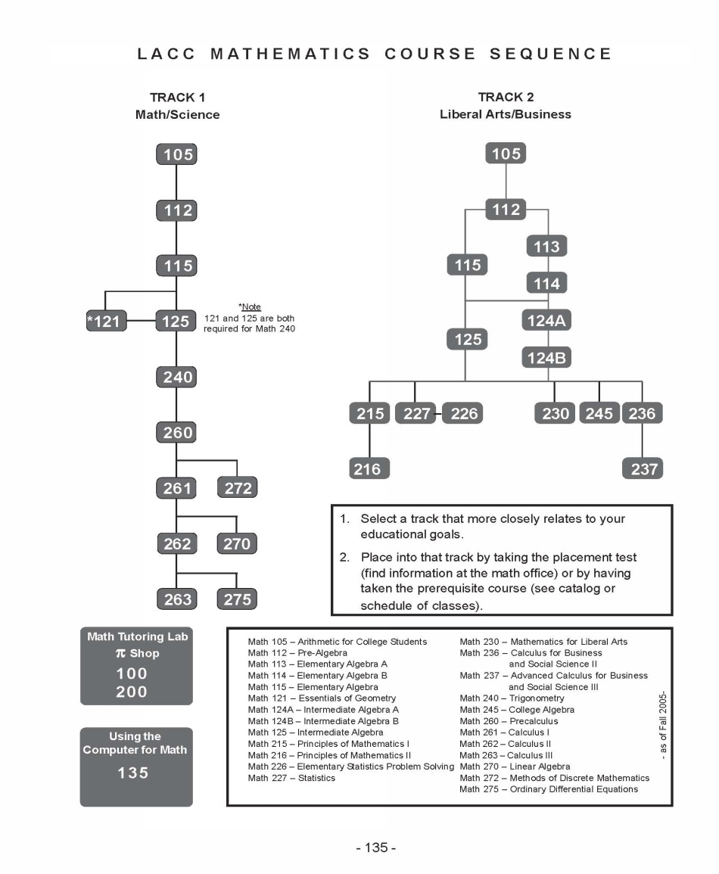
Math Sequence (2009)

