Slide 1
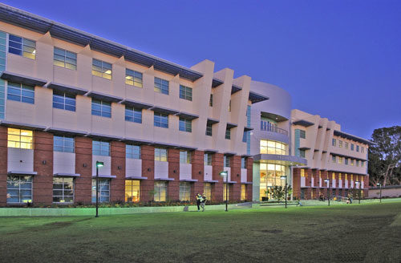
East Los Angeles Community College

Slide 2
Content
Introduction
Enrollment Trends
Demographic Characteristics
Transfers
Financial Aid
Math Sequence

Slide 3
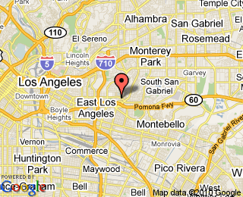
Introduction
Located in the suburban community of Monterey Park, California, 10 miles east of downtown Los Angeles
Website: www.elac.edu

Slide 4
Enrollment Trends
Overall, increasing trends since 1985

Slide 5
Enrollment Trends
All ages show increase except 35 and above

Slide 6
Demographics Characteristics
Between 2000 and 2009, the majority of LACC students were U.S. high school graduates.

Slide 7
Demographics Characteristics
Hispanic – majority population
Very low White, Black, and Other

Slide 8
Demographics Characteristics
Stable, 60 to 40 ratio

Slide 9
Demographics Characteristics
~65% English. ~20% Spanish, ~15% Other

Slide 10
Demographics Characteristics
High proportion of high school graduates

Slide 11
Transfers
The majority of students transfer to a CSU.

Slide 12
Transfers
Majority Hispanic transfers

Slide 13
Transfers
Within 6 years, 32% of students transfer who aimed to transfer

Slide 14
Financial Aid
~75% of students receive financial aid

Slide 15
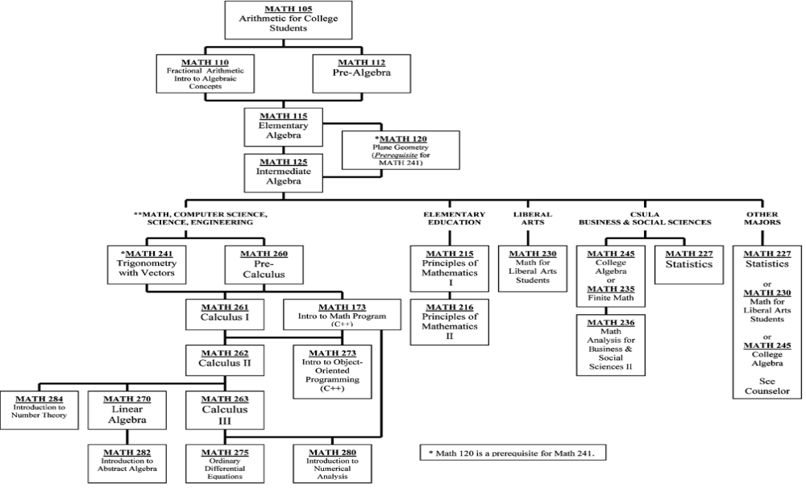
Math Sequence

