Slide 1
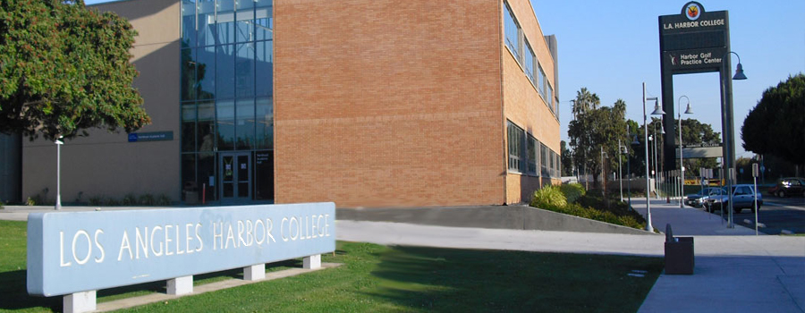
Los Angeles
Harbor College

Slide 2
Content
Introduction
Enrollment Trends
Demographic Characteristics
Transfers
Financial Aid
Math Sequence

Slide 3
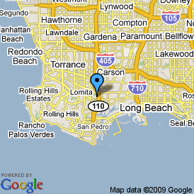
Introduction
Located off the 110 Harbor Freeway between Wilmington and Harbor City
Website: www.lahc.edu

Slide 4
Enrollment Trends
Steady increase from 1949 – 1980
Decreasing trend from 1980 to now

Slide 5
Enrollment Trends
Steady enrollment trends
Slight decline in concurrent high school students

Slide 6
Demographics Characteristics
Majority of students are US citizens, followed by permanent residents

Slide 7
Demographics Characteristics
Steady 60 to 40 ratio

Slide 8
Demographics Characteristics
Majority of students are Hispanic
White, Black, and Asian are evenly distributed

Slide 9
Demographics Characteristics
Majority are US high school graduates

Slide 10
Transfers
Mostly vocational and transfer
Followed by discover a new career, prepare for a new career, and general education

Slide 11
Transfers
Consistent numbers of transfers to CSUs and UCs

Slide 12
Transfers
Majority of transfers is consistently White students

Slide 13
Transfers
Majority of transfers is consistently Hispanic followed by White students

Slide 14
Transfers
Within 6 years, 33% of students transfer who aimed to transfer

Slide 15
Financial Aid
~75% of students receive some form of financial aid

Slide 16
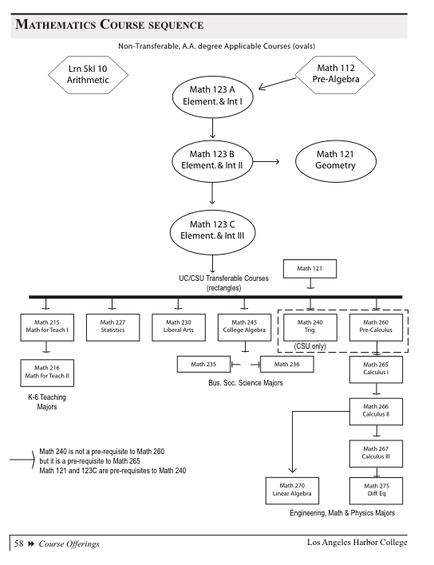
Math Sequence

