Slide 1
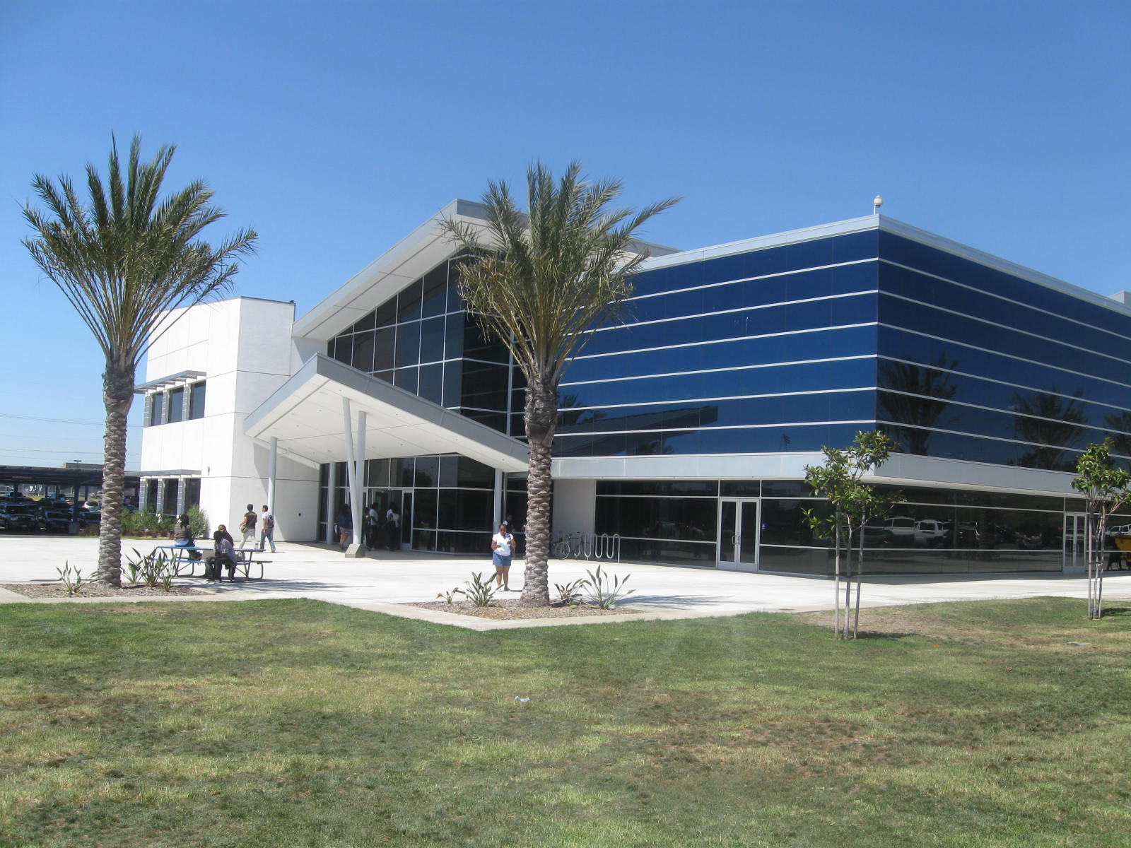
Los Angeles
Southwest College

Slide 2
Content
Introduction
Enrollment Trends
Demographic Characteristics
Transfers
Financial Aid
Math Sequence

Slide 3
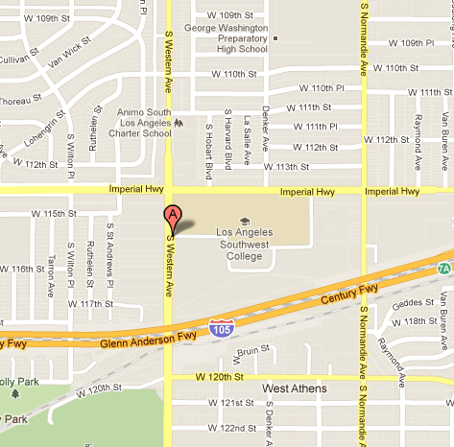
Introduction
LASC is located on 1600 West Imperial Highway
Website: www.lasc.edu

Slide 4
Enrollment Trends
Slight increase in enrollment since 2007

Slide 5
Enrollment Trends
Between 2000 and 2010, enrollment for age group 20-24 increased while others have slightly declined

Slide 6
Demographics Characteristics
Majority of students enrolled at U.S. citizens

Slide 7
Demographics Characteristics
Majority of students are Black, followed by Hispanic students.
Low numbers of Asian and White students.

Slide 8
Demographics Characteristics
Majority of students are females

Slide 9
Demographics Characteristics
English speakers are the majority and have continued to
increase since 1993

Slide 10
Demographics Characteristics
High school graduates continue to increasingly enroll since a decline in 2005

Slide 11
Transfers
Most students intend to transfer

Slide 12
Transfers
More students transfer to a CSU than a UC

Slide 13
Transfers
Majority of students that transfer to a CSU are Black

Slide 14
Transfers
The number of transfer students to a UC by ethnicity have fluctuated since 2000.

Slide 15
Financial Aid
Approximately 86% of students receive some form of
financial aid

Slide 16
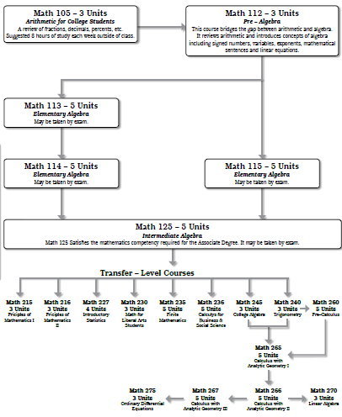
Math Sequence

