Slide 1

Los Angeles Trade Technical College

Slide 2
Content
Introduction
Enrollment Trends
Demographic Characteristics
Transfers
Financial Aid
Math Sequence

Slide 3
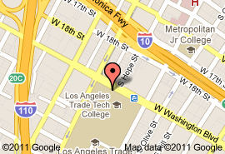
Introduction
Located in the City of Los Angeles approximately two miles south of the Central Business district
Website: college.lattc.edu

Slide 4
Enrollment Trends
Enrollment decreased after 1975 and has been on a slight increase since 2006

Slide 5
Enrollment Trends
Enrollment of age groups 20-24, 25-34 and 35+ have increased since 2004

Slide 6
Enrollment Trends
Between 1995 to 2010, a majority of students were U.S. citizens and the number of permanent residents declined

Slide 7
Demographics Characteristics
Since 1972, the number of Hispanics has greatly increased while the number of Blacks has decreased

Slide 8
Demographics Characteristics
The number of females at LATTC has increased since 1972

Slide 9
Demographics Characteristics
The number of Spanish speakers has decreased since 2000

Slide 10
Demographics Characteristics
# Enrolled by Educational Attainment: Fall 2000 - 2010
U.S. high school graduates are the majority of students at LATTC and have increased since 2006

Slide 11
Transfers
The number of students who have a vocational goal has declined since 2000

Slide 12
Transfers
From 1981 to 2010, more students transferred to a CSU than a UC

Slide 13
Transfers
In 2007, Hispanics were the largest ethnic group to transfer to both a UC and a CSU

Slide 14
Financial Aid
Approximately 88% of full-time students received financial aid

Slide 15
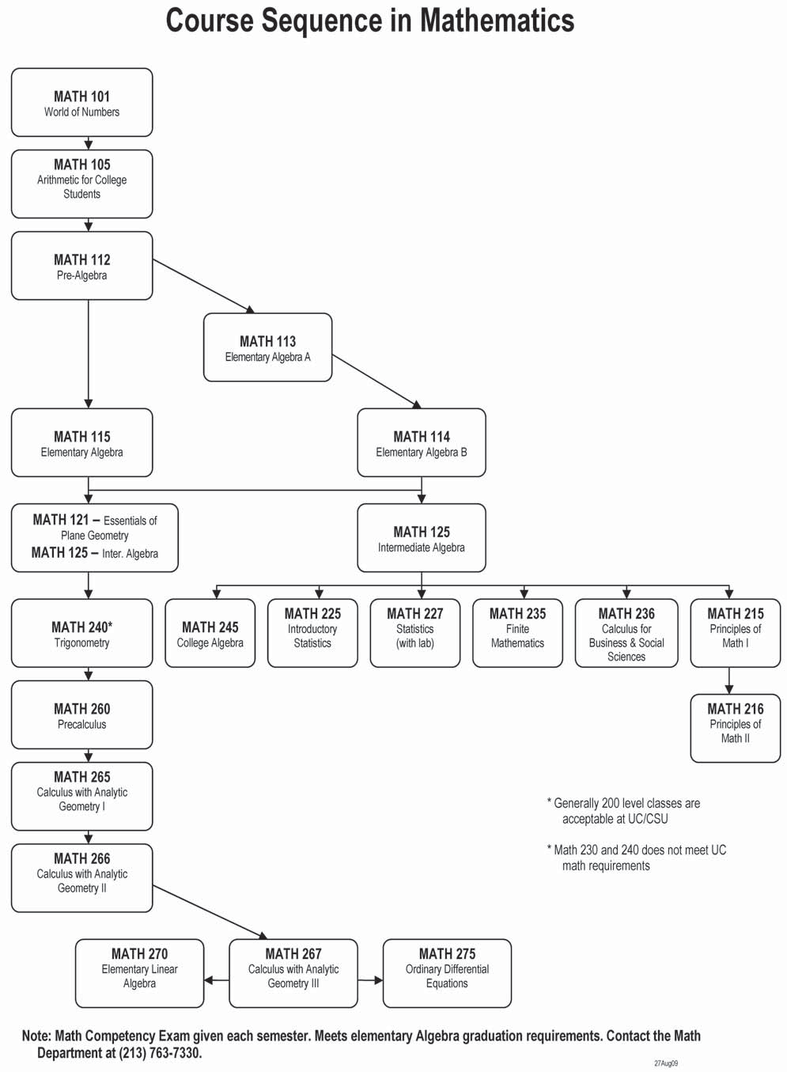
Math Sequence

