Slide 1
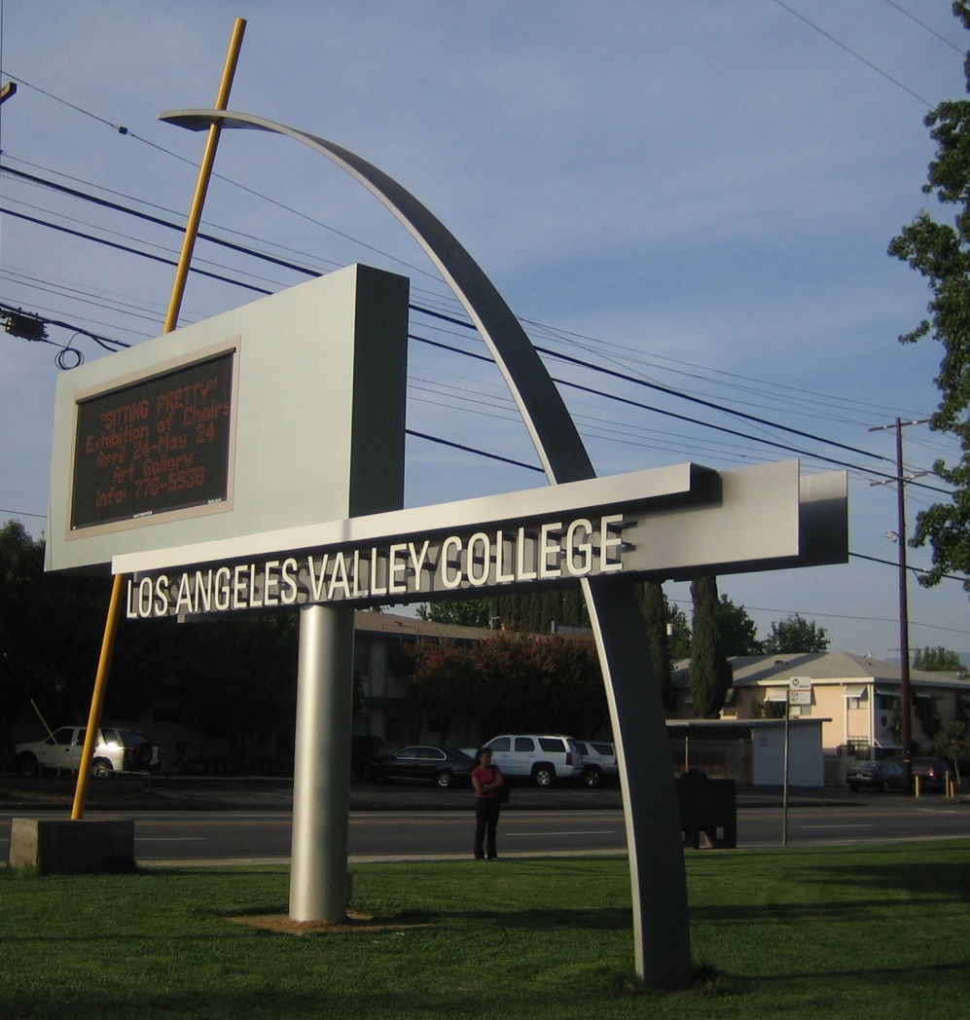
Los Angeles
Valley College

Slide 2
Content
Introduction
Enrollment Trends
Demographic Characteristics
Transfers
Financial Aid
Math Sequence

Slide 3
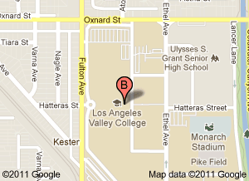
Introduction
Los Angeles Valley College is a 2-year public college located in the heart of Los Angeles’s San Fernando Valley.
Website: www.lavc.edu

Slide 4
Enrollment Trends
Enrollment increased from 1949 to 1975 and has fluctuated since then.

Slide 5
Enrollment Trends
Enrollment decreased in most age groups from 2002 to 2006 and
have since been on an upward trend

Slide 6
Demographics Characteristics
Enrollment of U.S. citizens has remained relatively stable while the number of enrollment of permanent residents has decreased

Slide 7
Demographics Characteristics
The number of Whites have decreased dramatically since 1972 and His-panics have become the largest ethnic student group

Slide 8
Demographics Characteristics
Between 1972 and 2010, females have become the larger proportion of students in the college

Slide 9
Demographics Characteristics
The number of English speakers has slightly increased while the number of Spanish speakers has decreased.

Slide 10
Demographics Characteristics
The majority of LAVC students were U.S. high school graduates and the number has continued to increased

Slide 11
Transfers
Since 1995, an increasing number of students expressed an interest to transfer

Slide 12
Transfers
Between 1981 to 2010, a majority of students transferred to a CSU

Slide 13
Transfers
Between 2000 to 2009, the largest ethnic group to transfer to a CSU was Hispanics

Slide 14
Transfers
Between 2000 to 2009, the largest ethnic group to transfer to a UC was Whites

Slide 15
Financial Aid
In 2007, most full-time students received financial aid

Slide 16
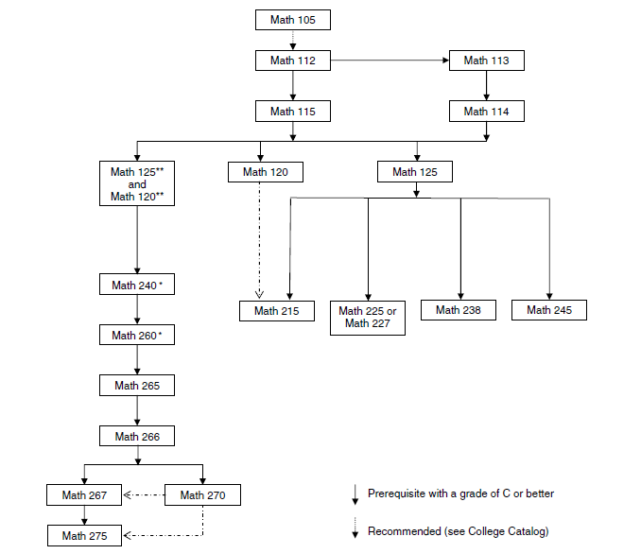
Math Sequence

