Slide 1
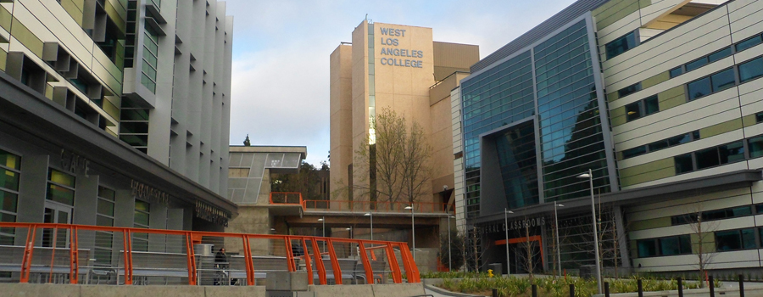
West Los
Angeles College

Slide 2
Content
Introduction
Enrollment Trends
Demographic Characteristics
Transfers
Financial Aid
Math Sequence

Slide 3
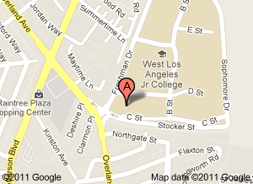
Introduction
Located in Culver City, California
Website: www.wlac.edu

Slide 4
Enrollment Trends
Enrollment decreased sharply after 1980 and has fluctuated and been on a slight increase since 2006

Slide 5
Enrollment Trends
The age groups under 20, 20-24, 25-34 and 35+ have increased since 2006

Slide 6
Demographics Characteristics
The majority of students at WLAC are U.S. citizens

Slide 7
Demographics Characteristics
The number of Blacks at WLAC has slightly declined while the Hisp-anic group has increased significantly

Slide 8
Demographics Characteristics
Since 1980, females are the largest proportion of students at WLAC

Slide 9
Demographics Characteristics
Since 1993, English speakers are the largest proportion of students

Slide 10
Demographics Characteristics
The number of U.S. high school graduates at WLAC has fluctuated since 1990 while the other groups have relatively remained the same

Slide 11
Transfers
The number of students who expressed interest in transferring has increased since 2005

Slide 12
Transfers
Since 1981, more students transfer to a CSU than a UC

Slide 13
Transfers
The majority of students who transfer to a CSU are Black

Slide 14
Transfers
Between 2000 to 2004, the majority of students who transfer to a UC were Black; from 2005 to 2009, the majority were Hispanic

Slide 15
Financial Aid
Approximately 65% of students receive some form of financial aid

Slide 16
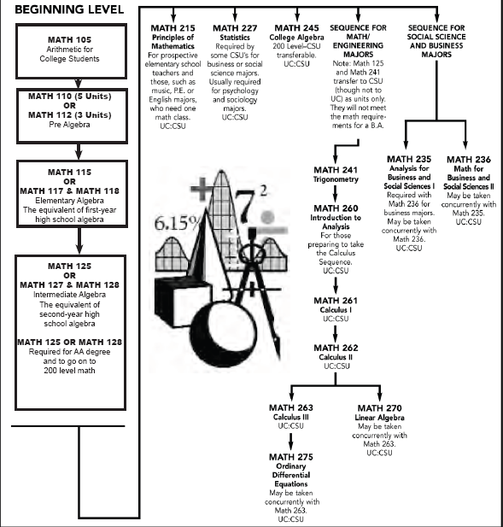
Math Sequence

