Slide 1
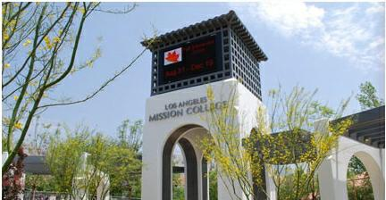
Los Angeles
Mission College

Slide 2
Content
Introduction
Enrollment Trends
Demographic Characteristics
Transfers
Financial Aid
Math Sequence

Slide 3
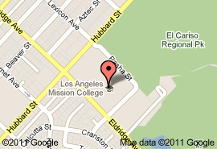
Introduction
Mission College is located in Sylmar and has strong, historical ties to its neighboring communities of San Fernando, Pacoima, Mission Hills, North Hills, Panorama City and Granada Hills.
Website: www.lamission.edu

Slide 4
Enrollment Trends
Steady increase in students
Slight decrease in students from 2002 - 2007

Slide 5
Enrollment Trends
Majority of the students enrolled are of the ages 20-24

Slide 6
Demographics Characteristics
Stable enrollment trends by citizenship
Majority are U.S. citizens

Slide 7
Demographics Characteristics
Approximately 70-75% of the students are Hispanic
White are approximately 10-15%
Black and Asian are both under 10%

Slide 8
Demographics Characteristics
Stable gender trends
Approximately 65% female and 35% male

Slide 9
Demographics Characteristics
The majority of the students are English speakers followed by Spanish speakers

Slide 10
Demographics Characteristics
Majority of students enrolled are U.S. high school graduates

Slide 11
Transfers
Significant increase in transfers

Slide 12
Transfers
Majority of students transfer to CSU
Steady number of transfers for both the CSU and UC

Slide 13
Transfers
Within 6 years, 35% of students who wanted to transfer successfully transferred

Slide 14
Transfers
Majority of students transferring to a CSU are Hispanic
Asian and unknown are the second most transfers to a CSU

Slide 15
Transfers
Majority of transfers to a UC are Hispanic
Trends have been stable

Slide 16
Financial Aid
Approximately 62% of students receive some form of
financial aid

Slide 17
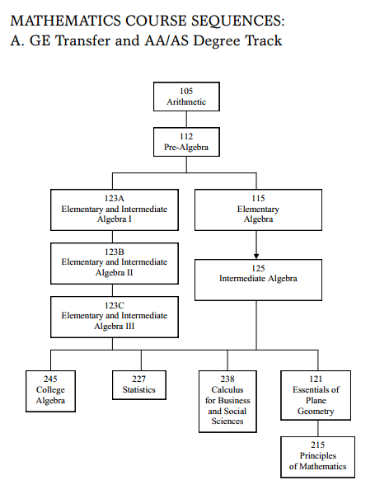
Math Sequence

