Slide 1
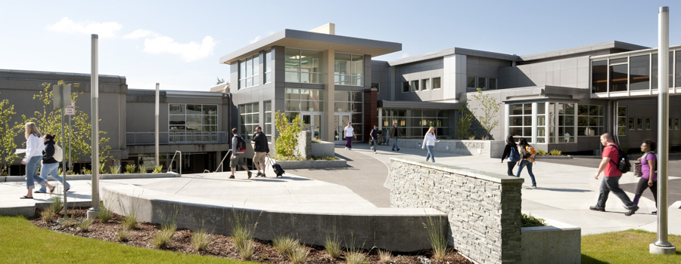
Los Angeles
Pierce College

Slide 2
Content
Introduction
Enrollment Trends
Demographic Characteristics
Transfers
Financial Aid
Math Sequence

Slide 3
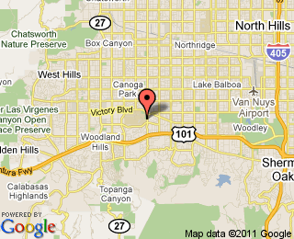
Introduction
Los Angeles Pierce College is a two-year community college that serves more than 20,000 students in Woodland Hills, a community within the San Fernando Valley region of the city of Los Angeles.
Website: www.piercecollege.edu

Slide 4
Enrollment Trends
Increase in enrollment from 1947 through 1975
Decrease in enrollment from 1983 through 1999
Steady increase in enrollment from 1999 to present

Slide 5
Enrollment Trends
Majority of the students enrolled are of the ages 20-24

Slide 6
Demographics Characteristics
Stable enrollment trends by citizenship
Majority of students are U.S. citizens

Slide 7
Demographics Characteristics
Majority of students are white and Hispanic
Asians are the third biggest population

Slide 8
Demographics Characteristics
Steady enrollment of ~55% females and ~45% males

Slide 9
Demographics Characteristics
Majority of the students are English speakers

Slide 10
Demographics Characteristics
Majority of students enrolled are U.S. high school graduates

Slide 11
Transfers
Majority of students aim to transfer

Slide 12
Transfers
Steady trends
Majority of students transfer to a CSU

Slide 13
Transfers
Approximately 45% of students who wanted to transfer successfully transferred

Slide 14
Transfers
Majority of students who transfer to a CSU are white
Steady trends

Slide 15
Transfers
Majority of transfers to a UC are white
Steady trends

Slide 16
Financial Aid
Approximately 43% of students receive some form of
financial aid

Slide 17
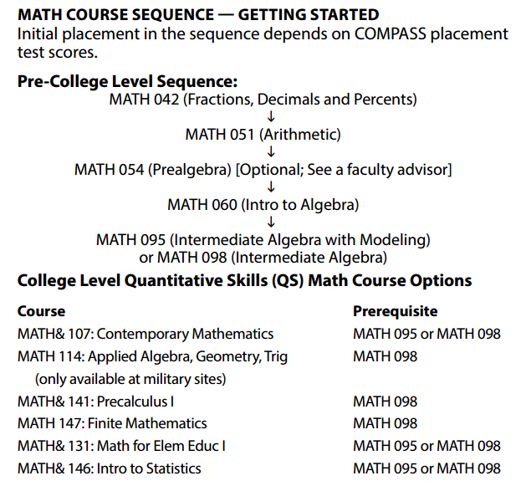
Math Sequence

